Slide 1


BMB3015 ARTIFICIAL INTELLIGENCE
DESIGN AND ANALYSIS OF
LEARNING SYSTEMS

Slide 2
Overfitting
Overfitting problem
Learning the hypothesis parameters so that hypothesis fits the training dataset too much
Then prediction performance over test dataset falls down
Mostly it is the reason of poor performance in learning systems
Possible for both regression and classification problems

Slide 3
Overfitting
After training
Training Set
Are you
here?
AUC (how good)
Testing Set
Model Complexity

Slide 4
Overfitting
After training
Want to
be here
Training Set
AUC (how good)
Testing Set
Model Complexity

Slide 5
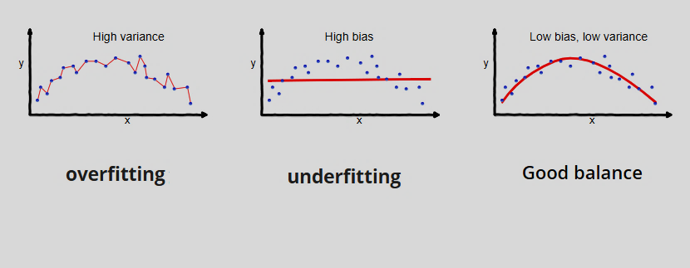
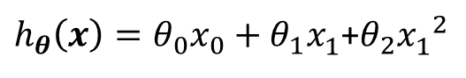
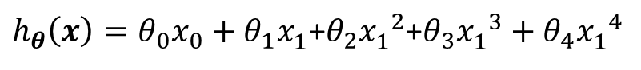
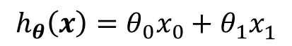
Overfitting in Regression
$$h_{θ}\left(x\right)=θ_{0}x_{0}+θ_{1}x_{1}^{ }$$
$h_{θ}\left(x\right)=θ_{0}x_{0}+θ_{1}x_{1}^{ }\text{+}θ_{2}{x_{1}^{ }}^{2}$+$θ_{3}{x_{1}^{ }}^{3}+θ_{4}{x_{1}^{ }}^{4}$
$h_{θ}\left(x\right)=θ_{0}x_{0}+θ_{1}x_{1}^{ }$+$θ_{2}{x_{1}^{ }}^{2}$

Slide 6
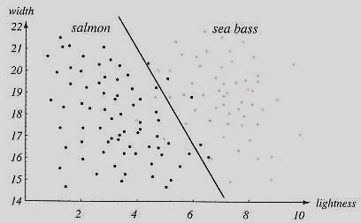
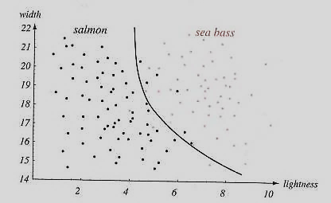
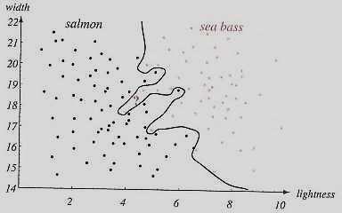
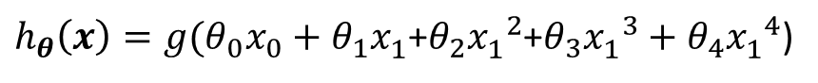
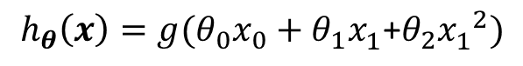
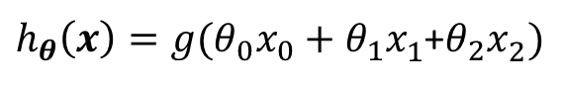
Overfitting in Classification
$h_{θ}\left(x\right)=g(θ_{0}x_{0}+θ_{1}x_{1}^{ }$+$θ_{2}x_{2}^{ })$
$$h_{θ}\left(x\right)=g(θ_{0}x_{0}+θ_{1}x_{1}^{ }\text{+}θ_{2}{x_{1}^{ }}^{2})$$
underfitting
«high bias»
Good balance
exactfitting
$h_{θ}\left(x\right)=g(θ_{0}x_{0}+θ_{1}x_{1}^{ }\text{+}θ_{2}{x_{1}^{ }}^{2}$+$θ_{3}{x_{1}^{ }}^{3}+θ_{4}{x_{1}^{ }}^{4}$)
overfitting
«high variance»
Notes:
High bias is equivalent to aiming in the wrong place. High variance is equivalent to having an unsteady aim.
This can lead to the following scenarios:
Low bias, low variance: Aiming at the target and hitting it with good precision.
Low bias, high variance: Aiming at the target, but not hitting it consistently.
High bias, low variance: Aiming off the target, but being consistent.
High bias, high variance: Aiming off the target and being inconsistent.
This is an often used illustration:
In machine learning terminology, underfitting means that a model is too general, leading to high bias, while overfitting means that a model is too specific, leading to high variance. When training a model, it is important to balance these two. Since you can’t realistically avoid bias and variance altogether, this is called the bias-variance tradeoff

Slide 7
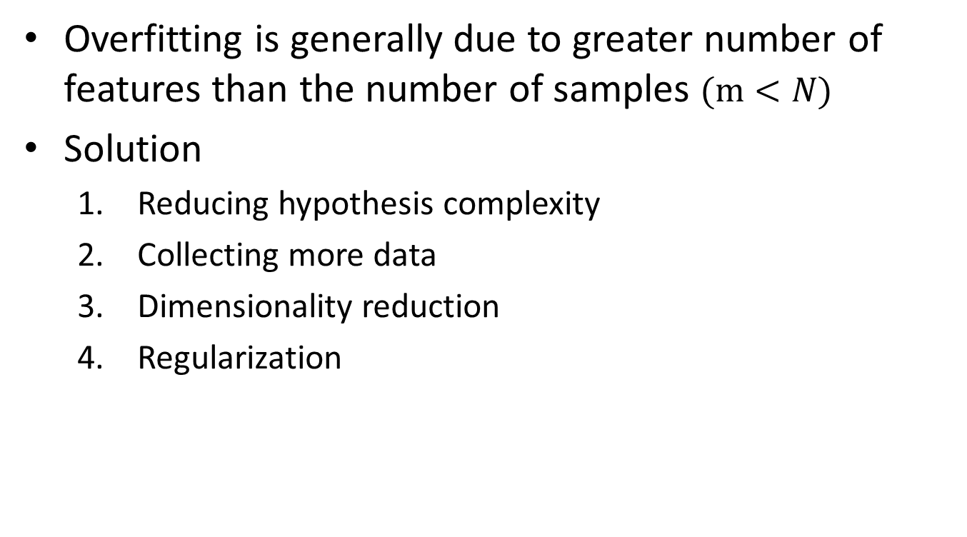
Solution to Overfitting
Overfitting is generally due to greater number of features than the number of samples $(m<N)$
Solution
Reducing hypothesis complexity
Collecting more data
Dimensionality reduction
Regularization

Slide 8
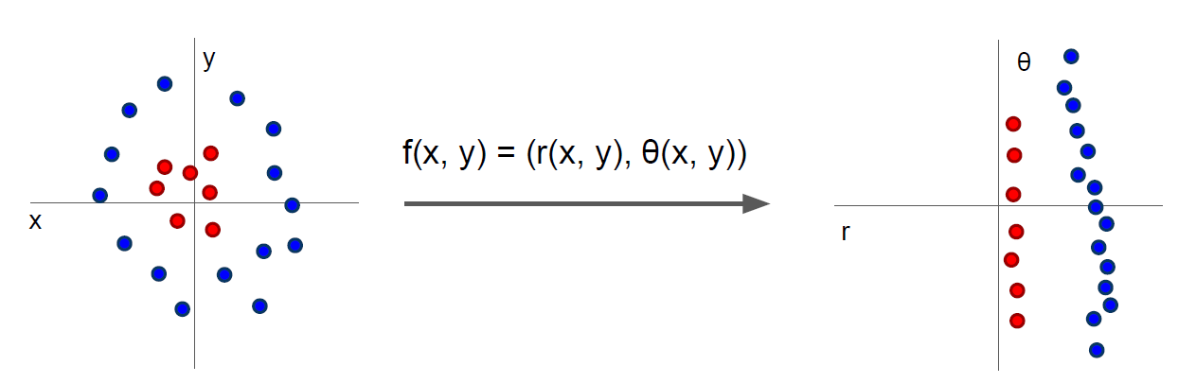
Dimensionality Reduction
Dimensionality reduction can be either by
Feature selection or
Feature transformation (Feature extraction)
Cannot separate red
and blue points with
linear classifier
After applying feature transform, points can be separated by linear classifier

Slide 9
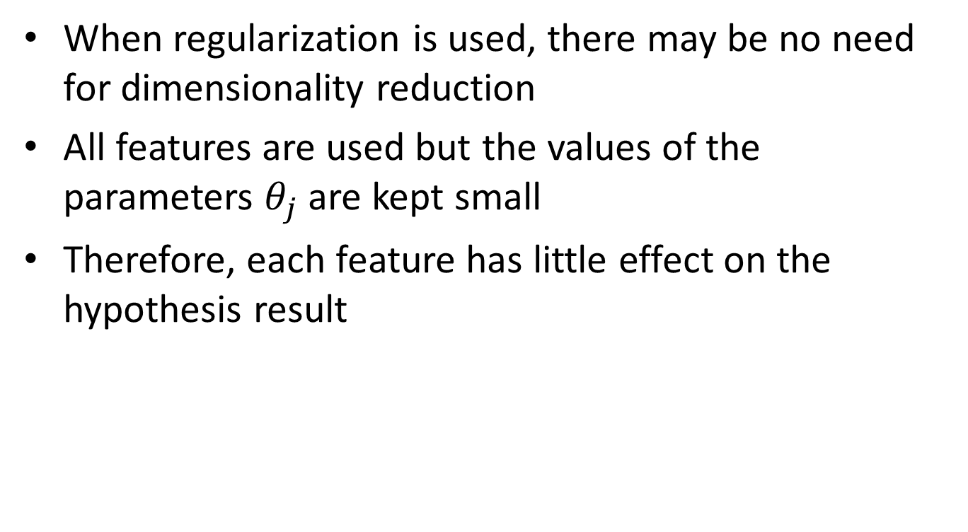
Regularization
When regularization is used, there may be no need for dimensionality reduction
All features are used but the values of the parameters $θ_{j}$ are kept small
Therefore, each feature has little effect on the hypothesis result

Slide 10
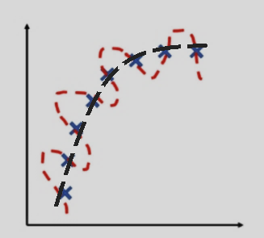
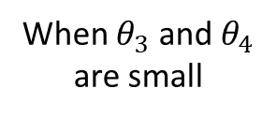
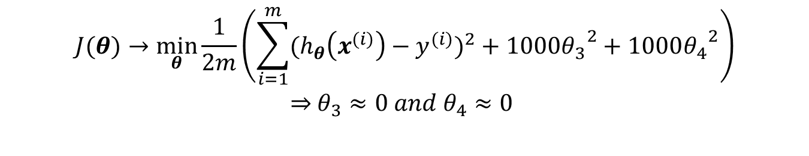
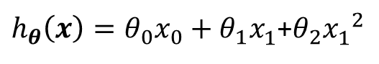
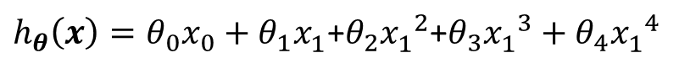
Regularization
$$J(θ)→\min_{θ}{\frac{1}{2m}\left(\sum_{i=1}^{m}{{(h_{θ}\left(x^{(i)}\right)−y^{(i)})}^{2}}+1000{θ_{3}}^{2}+1000{θ_{4}}^{2}\right)}$$
$θ_{3}≈0 and$ $θ_{4}≈0$
$h_{θ}\left(x\right)=θ_{0}x_{0}+θ_{1}x_{1}^{ }$+$θ_{2}{x_{1}^{ }}^{2}$
When $θ_{3}$ and $θ_{4}$ are small
$h_{θ}\left(x\right)=θ_{0}x_{0}+θ_{1}x_{1}^{ }\text{+}θ_{2}{x_{1}^{ }}^{2}$+$θ_{3}{x_{1}^{ }}^{3}+θ_{4}{x_{1}^{ }}^{4}$

Slide 11
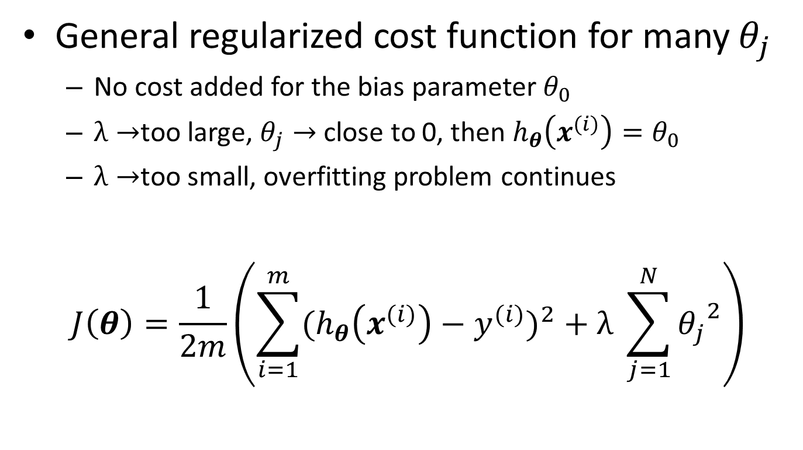
Regularization
General regularized cost function for many $θ_{j}$
No cost added for the bias parameter$θ_{0}$
$λ→$too large, $θ_{j}→$ close to 0, then $h_{θ}\left(x^{(i)}\right)=θ_{0}$
$λ→$too small, overfitting problem continues
$$J\left(θ\right)=\frac{1}{2m}\left(\sum_{i=1}^{m}{{(h_{θ}\left(x^{(i)}\right)−y^{(i)})}^{2}}+λ \sum_{j=1}^{N}{{θ_{j}}^{2}}\right)$$
Regularization term
Regularization parameter

Slide 12
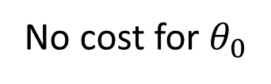
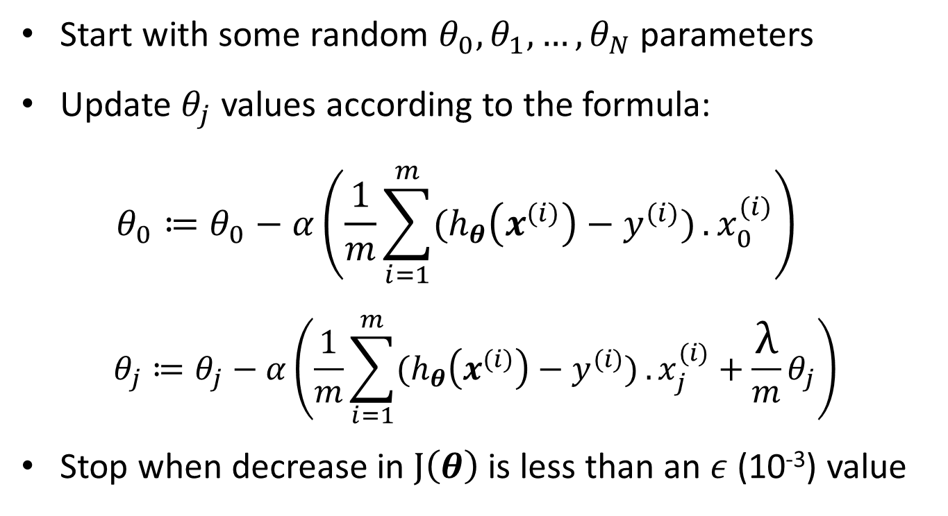
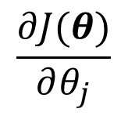
Gradient Descent: Linear Regression with Regularization
Start with some random $θ_{0},θ_{1},…,θ_{N}$ parameters
Update $θ_{j}$ values according to the formula:
$$θ_{0}≔θ_{0}−α\left(\frac{1}{m}\sum_{i=1}^{m}{(h_{θ}\left(x^{(i)}\right)−y^{(i)})}.x_{0}^{(i)}\right)$$
$$θ_{j}≔θ_{j}−α\left(\frac{1}{m}\sum_{i=1}^{m}{(h_{θ}\left(x^{(i)}\right)−y^{(i)})}.x_{j}^{(i)}+\frac{λ}{m}θ_{j}\right)$$
Stop when decrease in $J\left(θ\right)$ is less than an $ε$(10⁻³) value
No cost for $θ_{0}$
$$\frac{∂J(θ)}{∂θ_{j}}$$

Slide 13
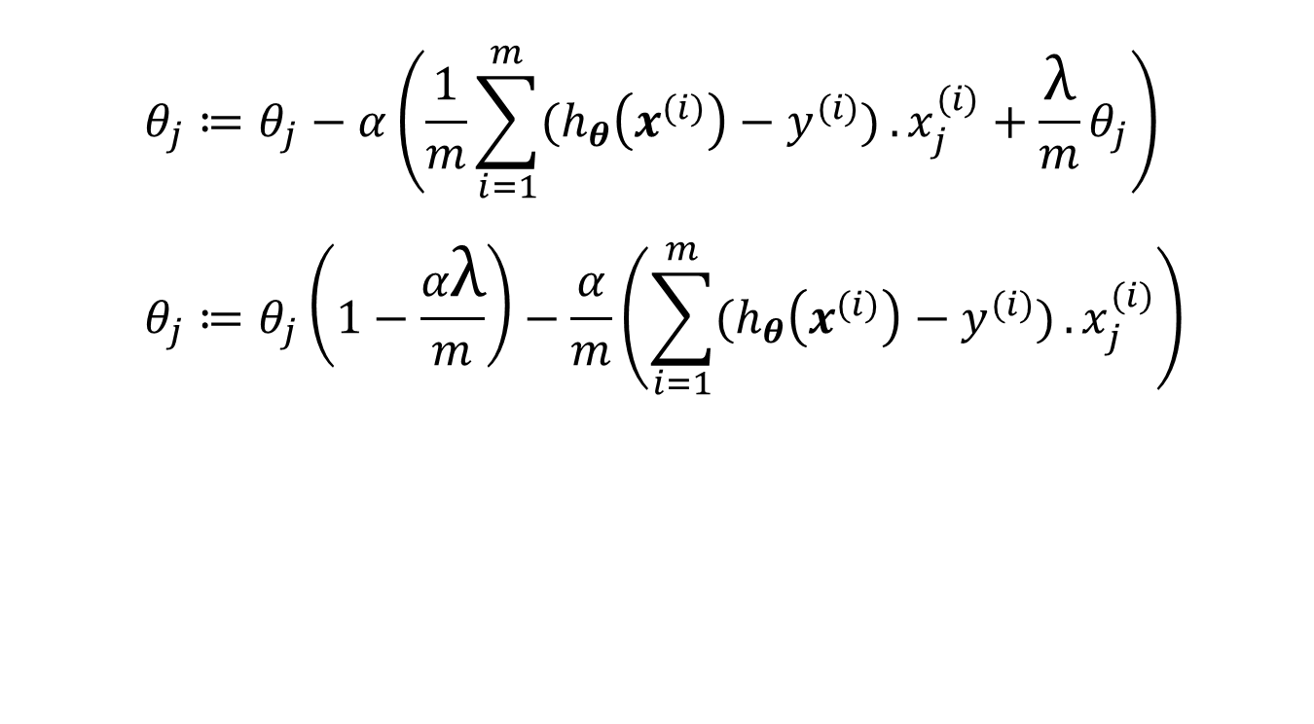
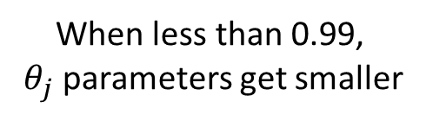
Gradient Descent: Linear Regression with Regularization
$$θ_{j}≔θ_{j}−α\left(\frac{1}{m}\sum_{i=1}^{m}{(h_{θ}\left(x^{(i)}\right)−y^{(i)})}.x_{j}^{(i)}+\frac{λ}{m}θ_{j}\right)$$
$$θ_{j}≔θ_{j}\left(1−\frac{αλ}{m}\right)−\frac{α}{m}\left(\sum_{i=1}^{m}{(h_{θ}\left(x^{(i)}\right)−y^{(i)})}.x_{j}^{(i)}\right)$$
When less than 0.99,
$θ_{j}$ parameters get smaller

Slide 14
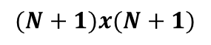
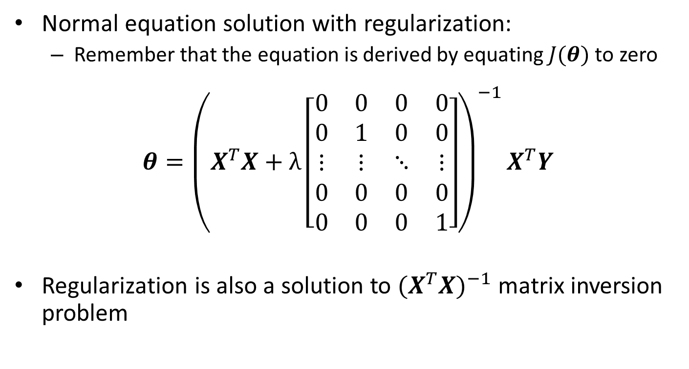
Normal Equation Solution: Linear Regression with Regularization
Normal equation solution with regularization:
Remember that the equation is derived by equating $J(θ)$ to zero
$$θ={{\left(X^{T}X+λ\left[\begin{matrix}0 & 0 & 0 & 0 \\ 0 & 1 & 0 & 0 \\ ⋮ & ⋮ & ⋱ & ⋮ \\ 0 & 0 & 0 & 0 \\ 0 & 0 & 0 & 1\end{matrix}\right]\right)}^{−1}X}^{T}Y$$
Regularization is also a solution to ${(X^{T}X)}^{−1}$ matrix inversion problem
$$(N+1)x(N+1)$$

Slide 15
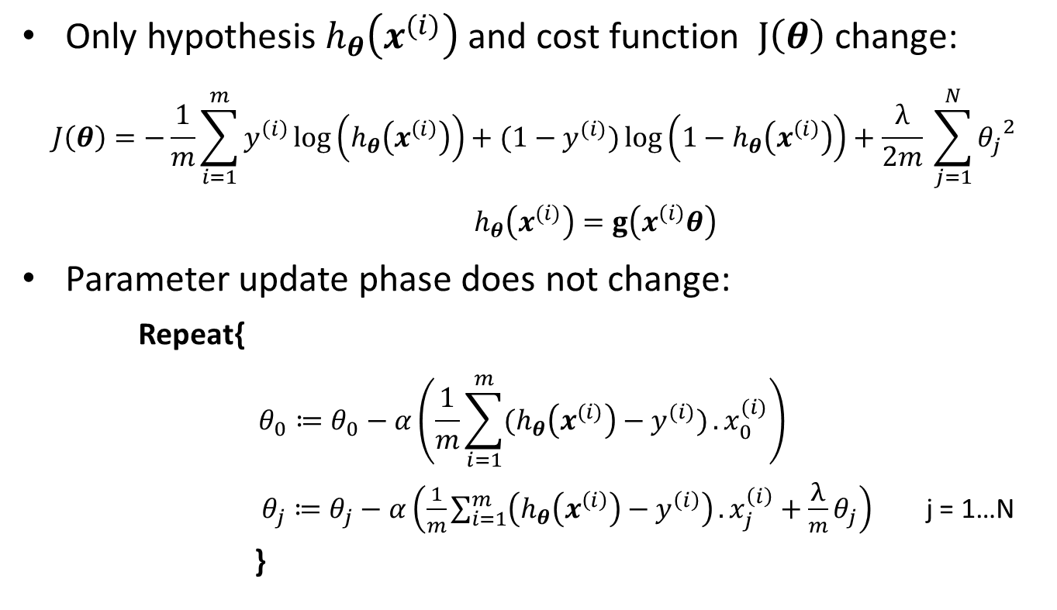
Gradient Descent: Logistic Regression with Regularization
Only hypothesis $h_{θ}\left(x^{(i)}\right)$ and cost function $J\left(θ\right)$ change:
$$J\left(θ\right)=−\frac{1}{m}\sum_{i=1}^{m}{y^{\left(i\right)}\log\left(h_{θ}\left(x^{\left(i\right)}\right)\right)+(1−y^{(i)})}\log\left(1−h_{θ}\left(x^{\left(i\right)}\right)\right)+\frac{λ}{2m} \sum_{j=1}^{N}{{θ_{j}}^{2}}$$
$h_{θ}\left(x^{(i)}\right)=g\left(x^{\left(i\right)}θ\right)$
Parameter update phase does not change:
Repeat{
$$θ_{0}≔θ_{0}−α\left(\frac{1}{m}\sum_{i=1}^{m}{(h_{θ}\left(x^{(i)}\right)−y^{(i)})}.x_{0}^{(i)}\right)$$
$θ_{j}≔θ_{j}−α\left(\frac{1}{m}\sum_{i=1}^{m}{\left(h_{θ}\left(x^{\left(i\right)}\right)−y^{\left(i\right)}\right)}.x_{j}^{\left(i\right)}+\frac{λ}{m}θ_{j}\right)$ j = 1…N
}

Slide 16
Cross Validation
Generally available dataset is split into 3 parts:
Training dataset: %80 - %60
Validation dataset: %10 - %20
Test dataset: %10 - %20
Training is performed using the training dataset
Parameters are optimized maximizing the performance over only validation dataset.
Prevents overfitting
With the best parameter combination, performance over test dataset is measured once, and overall accuracy is determined.

Slide 17
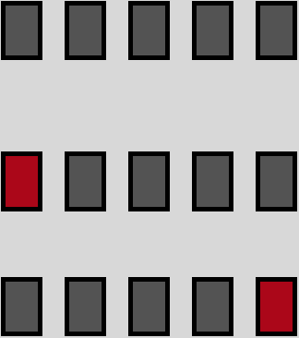
N-Fold Cross Validation
Available dataset is split into N equal parts
N is generally 10 or 5
Use one part for testing (validation) and the others for training
Repeat N times
Test
Test

Slide 18
Cross Validation Processing Steps
Split available dataset as train, validation, and test
Decide model and model parameters
Train the model using training dataset
Measure the performance of the model using validation dataset
Try steps from 2 to 4 for different models and model parameters
Choose the model and model parameters with the least error on validation dataset
Train the chosen model with the chosen model parameters using both the training and validation dataset
Final accuracy is computed evaluating the model on test dataset
Training and validation sets are alternated N times in N-fold cross validation
The averaged performance on N validation datasets determine the best parameters and model
Steps 3 and 4 are repeated N times

Slide 19
Cross Validation Processing Steps
Training Data
Model types T
N-Fold CV
Training data 1
Learning System
Classifier 1,1,1
Validation data 1
Training data 2
Classifier 2,1,1
Validation data 2
.
.
.
.
.
.
.
.
.
Training data N
Model parameters P
Classifier N,T,P
Validation data N
Best Model Type
Actual
Labels
Test Data
Learning System
Evaluation System
Training + Validation Data
Predicted
Labels
Accuracies
Classifier T_{best}, P_{best}
Best Model Parameters

Slide 20
AdaBoost Training
Bootstrapping method
Data set for training the model is augmented replicating the samples within dataset
Bagging→ Bootstrap aggregation
AdaBoost Algorithm:
M: number of different models
for m=1 to M
Select subset S_{m} from dataset using bootstrap method
Train classifier C_{m} using the subset S_{m}
For each test sample
for m=1 to M obtain class label of C_{m} classifier for the test sample
The class label with the highest rate is assigned to the test sample
Notes:
Bootstrapping: ön yükleme
Bootstrap aggregation: ön yükleme kümelemesi

Slide 21
AdaBoost Training
Bagging
Bootstrapped data 1
Learning System
Classifier 1
Training Data
Bootstrapped data 2
Classifier 2
.
.
.
.
.
.
Test Data
Classifier 1
Voting System
Test Data
Class Labels
Classifier 2
.
.
.

Slide 22
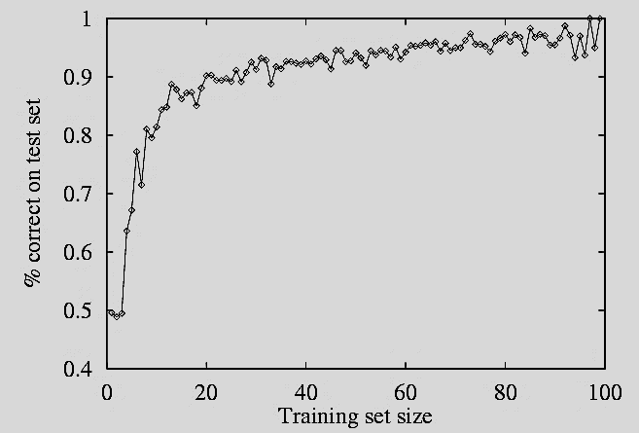
Performance Measurement
How do we know that h ≈ f ?
Use theorems of computational/statistical learning theory
Try h on a new test set of examples
use same distribution over example space as training set
shuffle the data before separating it for train and test
Learning curve = % correct on test set as a function of training set size

Slide 23
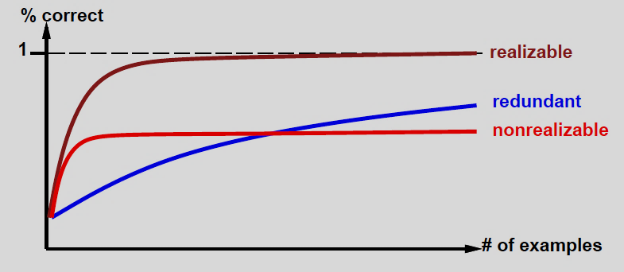
Learning Curve
depends on
realizable vs. non-realizable
realizable means that target function can be expressed
non-realizability can be due to missing features or restricted hypothesis class
e.g., thresholded linear function
redundant expressiveness
e.g., loads of irrelevant features

Slide 24
Error Analysis
Exact fit
High variance
(overfit)
High bias
(underfit)
As the model complexity increases,
error in training data set gradually falls,
but error in test data set rises after some point
Optimal point where exact fit is found is different for each data set
Error
Model Complexity
Trade-off between:
Overfitting (overtraining or memorising) versus underfitting (generalization)

Slide 25
Evaluation Metrics
For a binary classifier performance is measured depending on
True or False positives and True or False negatives
The classification threshold affects performance
True positives
# of samples for which predicted label = 1 and actual label = 1
False positives
# of samples for which predicted label = 1 and actual label = 0
True negatives
# of samples for which predicted label = 0 and actual label = 0
False negatives
# of samples for which predicted label = 0 and actual label = 1

Slide 26
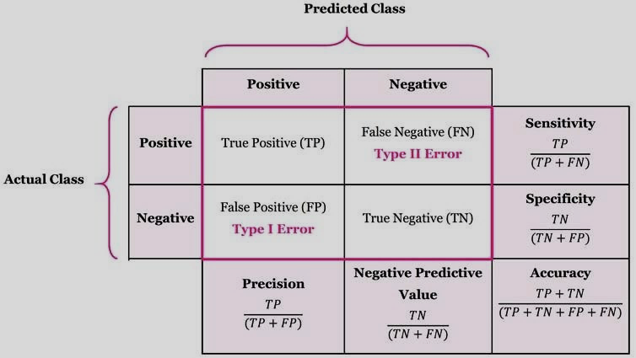
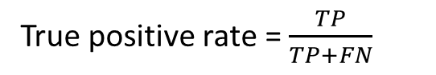
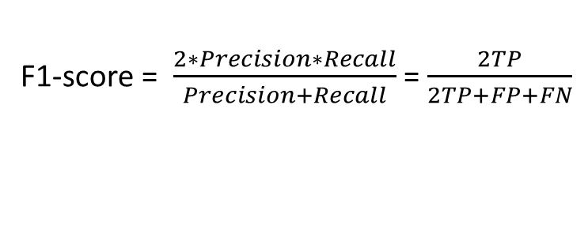
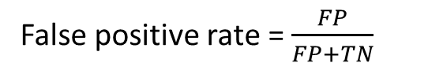
Evaluation Metrics
Related metrics:
Sensitivity (TP rate, Recall)
Specificity
Precision
Negative predicted value
Accuracy
F1-score
FP rate
F1-score = $\frac{2∗Precision∗Recall}{Precision+Recall}$ = $\frac{2TP}{2TP+FP+FN}$
True positive rate = $\frac{TP}{TP+FN}$
False positive rate = $\frac{FP}{FP+TN}$

Slide 27
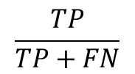
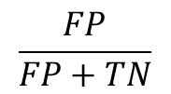
Reciever Operator Characteristic (ROC) Curve
TPR vs FPR at another classification threshold
ROC curve plots FPR vs. TPR at different classification thresholds.
Indicates performance of a classification model at all classification thresholds.
Lowering the classification threshold classifies more items as positive, thus increasing both False Positives and True Positives.
Want to maximize two dimensional area under the ROC curve (AUC)
Useful for comparing different classification methods
TPR vs FPR at one classification threshold
1
0
0.7
0.53
true positive rate
$$\frac{TP}{TP+FN}$$
1
0
1
false positive rate
0.1
$$\frac{FP}{FP+TN}$$
ROC curve
« Receiver Operator Characteristic »

Slide 28
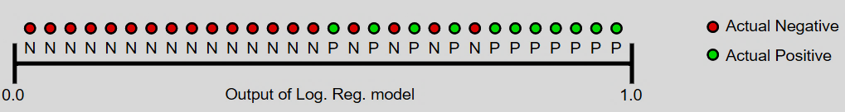
Area Under Curve (AUC)
AUC is an efficient sorting-based algorithm to compute ROC curve points
measures the quality of the model's predictions irrespective of what classification threshold is chosen.
measures how well predictions are ranked, rather than their absolute values
Predictions are ranked in ascending order of logistic regression score
AUC represents the probability that a random positive (green) example is positioned to the right of a random negative (red) example
ranges in value from 0 to 1.
A model whose predictions are 100% wrong has an AUC of 0.0
A model whose predictions are 100% correct has an AUC of 1.0
Not a useful metric for all types of problems!
Notes:
In cases where there are wide disparities in the cost of false negatives vs. false positives, it may be critical to minimize one type of classification error. For example, when doing email spam detection, you likely want to prioritize minimizing false positives (even if that results in a significant increase of false negatives). AUC isn't a useful metric for this type of optimization.

Slide 29
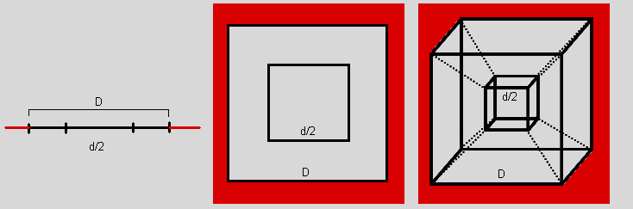
Multi-Dimensional Data
center
center
center
1-dimensional
2-dimensional
3-dimensional
Number of dimensions | Percentage of points close to center (%)
1 | 50
2 | 25
3 | 12,50
… | …
P | (½)^{p}
As number of dimensions increases more data samples stand close to the decision boundaries that separate classes
This results in a more difficult classification problem

Slide 30
Multi-Dimensional Data
With 10 sample points each of which represents a space range of [0,1]
Assume average distance of a random point to the closest sample point that represents the space is 0.5
In two dimensional space, for the average horizontal and vertical distance of a random point to the closest sample point that represents the space is to be 0.5,
number of required representative points is 100
Number of dimensions | Required representative point number
1 | 10
2 | 100
3 | 1000
… | …
p | 10^{p}
Required number of samples for accurate classification increases with the number of dimensions

Slide 31
Dimensionality Reduction
Feature Selection Methods
Information Gain (IG)
Signal to Noise (S2N) ratio
Wrappers (Subset selectors)
Feature Extraction Methods
Principal Component Analysis
Linear Discriminant Analysis
Local Fisher Discriminant Analysis
…
The kernelized versions of the same methods

Slide 32
Which Dimension to Select?

Slide 33
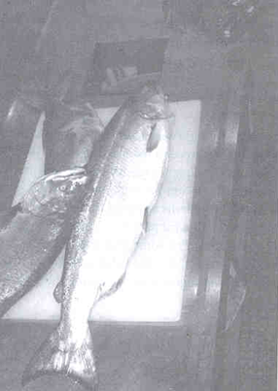
Fish Classification Problem
Is fish on conveyor belt salmon or sea bass?
camera
Preprocessing
Feature Extraction
Classification
salmon
sea bass
Notes:
Sea bass levrek
Salmon somon

Slide 34
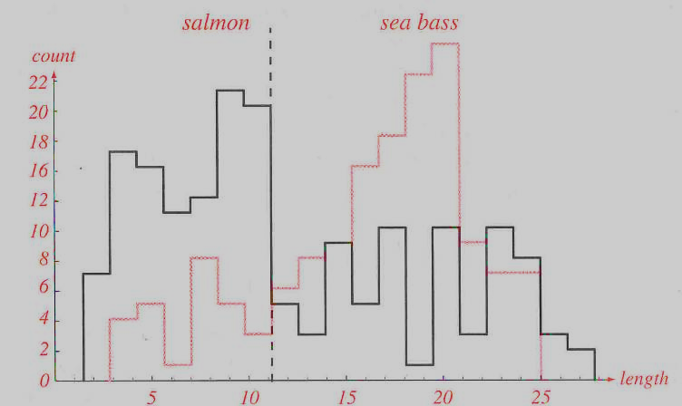
Fish Features: Length
The salmon is generally shorter than the sea bass.

Slide 35
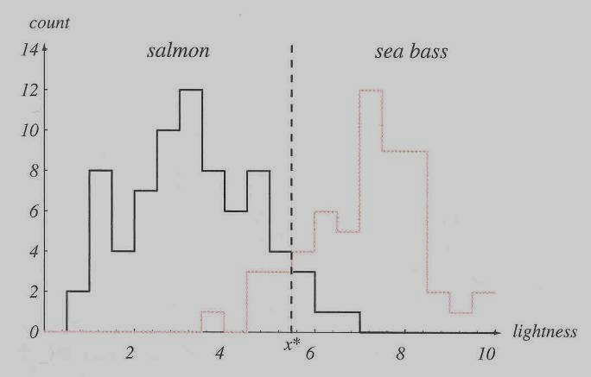
Fish Features: Lightness
The sea bass is generally brighter than the salmon.

Slide 36
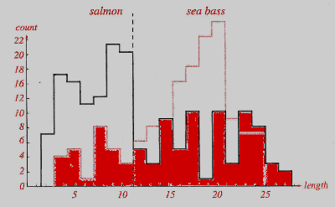
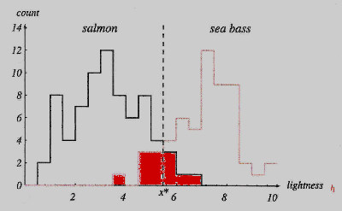
Which Feature is Better?
Red areas indicate the errors after classification.

Slide 37
Doctor’s Analysis Problem
A doctor
Data:
files of personal information
Task:
Finding who are patient
Information to be analysed
Name-Surname
Birthplace
Gender
Blood analysis
Radiological analysis
etc.
Feature 1 | Feature 2 | Class
1 | 3 | A
2 | 3 | B
1 | 4 | A
2 | 3 | B

Slide 38
Tiring the Doctor
What if 5000 features are there in the files?
There might be a DNA sequence to be analyzed.
How should the locations in the DNA sequence be determined for examination?
Solution is to use computerized methods.

Slide 39
Feature Selection
Two computerized solutions to this problem
Selecting some of available features
Filters
Wrappers
Extracting some new features from linear combinations of available features

Slide 40
Filters
Evaluate each feature in the training set one by one
Try to find an answer to the following question
What if only this feature is available to evaluate the samples?
Change of labels or values together with the change in the selected feature is analysed.
The greater is the change in classes or values with the change in a feature, the more is the effect of that feature on the result.

Slide 41
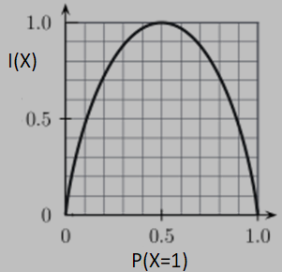
Entropy
Entropy (Information Content) of a subset for c classes

Slide 42
Information Gain
Choose a feature (attribute) A that
has v distinct values
divides the training set E into subsets E₁, … , E_{v} according to its values
Then,
Information Gain (IG) from the feature test:
Choose the feature with the largest IG

Slide 43
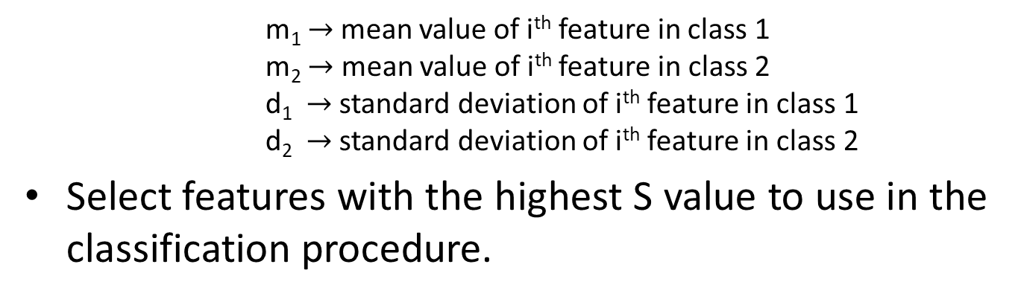
Signal-to-Noise Ratio
Select features with higher inter-class and lower intra-class separation
m₁$→$ mean value of i^{th} feature in class 1
m₂ $→$ mean value of i^{th} feature in class 2
d₁ $→$ standard deviation of i^{th} feature in class 1
d₂ $→$ standard deviation of i^{th} feature in class 2
Select features with the highest S value to use in the classification procedure.

Slide 44
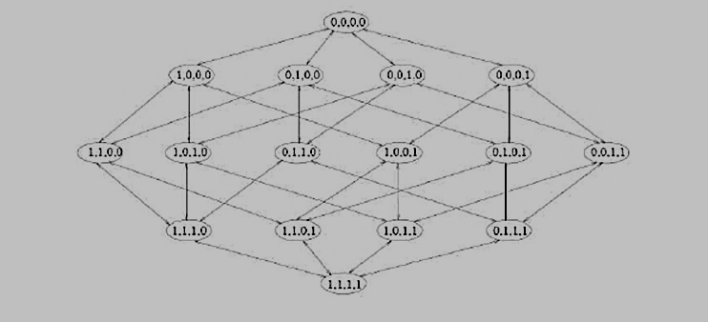
Wrappers
Find an optimized feature subset
generate some feature subsets
use classifiers to measure their performances
For N features 2^{N} feature subsets = 2^{N} trainings possible

Slide 45
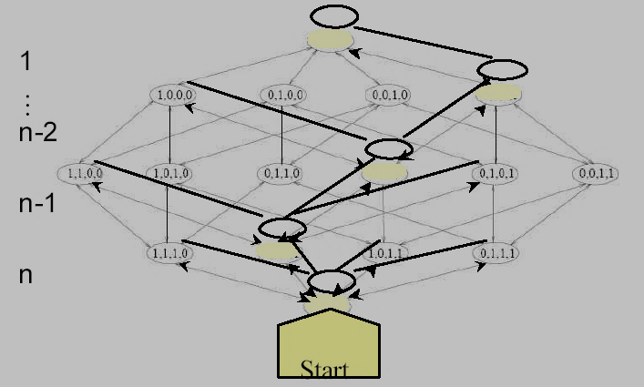
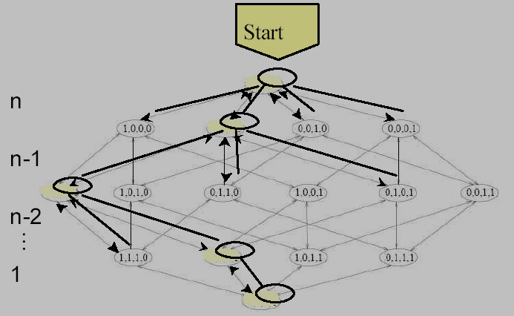
Wrappers
To speed up, instead of trying all possibilities
Start with all features and remove one at each step
Start with a single feature and add one at each step
The path to be followed is decided depending on the classification performance of that feature subset.

Slide 46
Feature Extraction
A new subspace of features is generated using linear combinations of available features
Then, data samples are represented in this subspace
Two commonly used methods:
Principal Component Analysis (PCA)
Linear Discriminant Analysis (LDA)

Slide 47
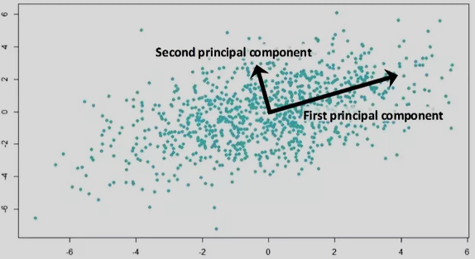
Principle Component Analysis - PCA
Dimensions with the highest variation in data samples are determined.
Two principal components for two dimensional data samples,
Variation is highest for the first principal component.
Two dimensional data samples can be projected on the first principal component.
Then they can be distinguishably represented with only one dimension.

Slide 48
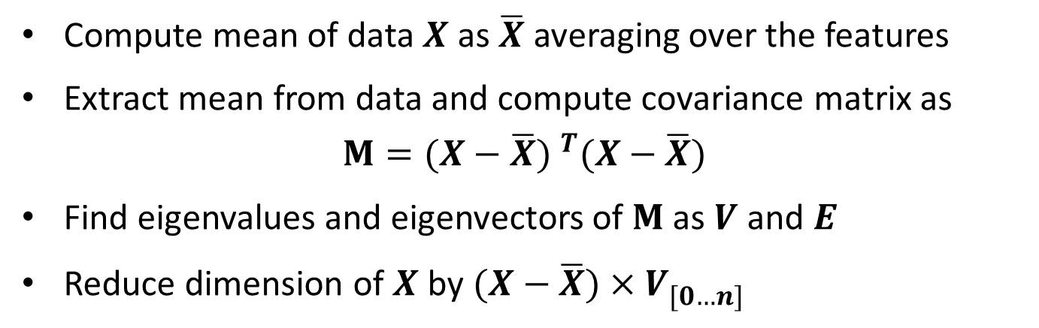
PCA - Algorithm
Compute mean of data $X$ as $\overline{X}$ averaging over the features
Extract mean from data and compute covariance matrix as
$$M={(X−\overline{X}) }^{T}(X−\overline{X})$$
Find eigenvalues and eigenvectors of $M$ as $V$ and $E$
Reduce dimension of $X$by $(X−\overline{X})×V_{[0…n]}^{ }$

Slide 49

Linear Discriminant Analysis - LDA
Reduces dimensionality using class label information in addition to variances of data samples
Maximizes classification performance while reducing dimensions of the data samples
LDA projection axis
PCA projection axis

Slide 50


LDA - Algorithm
Find a vector $w$ which maximizes the separation between target classes after projecting them onto $w$.
non-optimal projection optimal projection

Slide 51



LDA – Orthogonal Projection
Assume that we already know $w$
$p$ is the orthogonal projection of $x$ onto $w$.
$d$ vector is the perpendicular distance between $x$ and $w$.
also known as the residual or error vector.
$$d=x−p$$
Since $p$ is parallel to $w$, the $d$ can be alternatively written as
$p=cw$ where $c$is some scaler
$$d=x−cw$$
Knowing that dot product between
the two orthogonal vectors is zero
$$p^{T}d=0→{\left(cw\right)}^{T}\left(x−cw\right)=0$$
$$→{cw}^{T} x−c^{2}w^{T}w=0→cw^{T}w=w^{T} x$$
$→$ $c=\frac{w^{T} x }{w^{T}w}$
$$p=cw→p=\frac{w^{T} xw}{w^{T}w}$$

Slide 52

LDA – Dimensionality Reduction
Assume that $w$ is a unit vector
$$w^{T}w=1$$
${\hat{x}}_{i}$ is the orthogonal projection of $x_{i}$ onto $w$
$${\hat{x}}_{i}=cw→{\hat{x}}_{i}=\frac{w^{T}x_{i}w}{w^{T}w}=w^{T}x_{i}w=a_{i}w$$
$a_{i}$ is a scaler value and the offset coordinate of$x_{i}$ on $w$.
A set of such scaler values $\left\{a_{1},a_{2},…,a_{n}\right\}$ represents the mapping from $R^{d}→R$
Therefore knowing the value of $w$, the dimension of the data can be reduced from d-dimension to 1-dimension

Slide 53







LDA – Finding Optimal $w$
Knowing the target class labels, the mean of the projected data points for each class is calculated separately
In order to maximize the separation between the classes, mean differences are maximized while class variances are minimized.
Fisher’s LDA formula is used:
Objective function is optimized
Eigenvalue-eigenvector decomposition of $S^{−1}B$ due to
$$S=\sum_{i}{S_{i}}$$
Notes:
For more detail refer to
http://www.adeveloperdiary.com/data-science/machine-learning/linear-discriminant-analysis-from-theory-to-code/

Slide 54

Singular Value Decomposition
Helps us to find solutions for linear systems
With SVD any mxn matrix can be written as
$A_{mxn}=U_{mxm}$ $D_{mxn}{V^{T}}_{nxn}$
Columns of $U$ and $V$ are mutually orthogonal unit vectors
Diagonal elements of $D$ are singular values $σ_{i}$ such that $σ_{1}≥$ $σ_{2}$ $≥$ $σ_{3}$…$≥$ $σ_{n}≥$ $0$
Although $U$ and $V$ are not unique$σ_{i}$ are fully determined by $A$

Slide 55

SVD Some Useful Properties
$A$is nonsingular if and only if all $σ_{i}>0$
Number of non-zero $σ_{i}$ equals the rank of $A$
Be $A$ singular or not, pseudoinverse of $A$ is
$A^{+}=V{D_{0}}^{−1}U^{T}$
where ${D_{0}}^{−1}={D_{ }}^{−1}$ for $σ_{i}≠0$
${D_{0}}^{−1}=0$ for $σ_{i}=0$
Columns of $U$ corresponding to non-zero $σ_{i}$ span the range of $A$
Columns of $V$ corresponding to zero $σ_{i}$ is the null-space of $A$
Non-zero ${σ_{i}}^{2}$ are non-zero eigenvalues of ${(A^{T}A)}_{nxn}$ or ${(AA^{T})}_{mxm}$
Columns of $U$ are eigenvectors of $AA^{T}$
Columns of $V$ are eigenvectors of $A^{T}A$

Slide 56

Applications of SVD I
Least-squares estimation:
To solve a system of nonhomogeneous linear equations of the form
$$Ax=b$$
Nonhomogeneous mean not all elements of b are 0
$x$ is vector of unknowns
$A$ is $mxn$ coefficients matrix
$b$ is $mx1$ data
$A^{T}Ax=A^{T}b→x={(A^{T}A)}^{+}A^{T}$b
SVD gives ${(A^{T}A)}^{+}$ from property 3
When we have more equations than unknowns ${(A^{T}A)}^{+}$gets closer to ${(A^{T}A)}^{−1}$

Slide 57

Applications of SVD II
Solving homogeneous systems
To solve a homogeneous system with m equations and n unknowns
$Ax=0$with $m≥n−1, rank\left(A\right)=n−1$
Disregarding the trivial solution $x=0$, a solution unique up to a scale factor is the eigenvector in $V$ corresponding to the only zero eigenvalue of $A^{T}A$
Since $rank\left(A\right)=n−1$ all other eigenvalues are positive
Form properties of 5 and 8

Slide 58

Applications of SVD III
Enforcing constraints
An estimate of $A$ can be constructed to enforce some constraints on $A$ such as independence or orthogonality as
$$\hat{A}=UD′V^{T}$$
$D′$ is obtained by changing the singular values of $D$ to those expected when the constraints are satisfied exactly.
Orthogonal matrices of fundamental matrix $F$ is a case in point

Slide 59


Homework IV
Ödevin ilk kısmında basit lineer regresyon problemi lineer regresyon ile çözülecektir.
regression.py dosyasında okunan data_regression.mat verisi 5-kat çapraz geçerleme tekniğiyle eğitim ve geçerleme olarak 5x2’ye ayrılacaktır.
Soldaki grafik, veri setindeki makina sayısına karşılık elde edilen kar değerleri için farklı örnekleri göstermektedir.
Veride 97 örnek mevcut olup tüm örneklerin 1 özelliği bulunmaktadır.
Ödevin ikinci kısmında basit ikili sınıflandırma problemi lojistik regresyon ile çözülecektir.
classification.py dosyasında okunan data_classification.mat verisi 5-kat çapraz geçerleme tekniğiyle eğitim ve geçerleme olarak 5x2’ye ayrılacaktır.
Sağdaki grafik, veri setindeki ‘x’= 1 ve ‘o’= 0 sınıfına ait örnekleri göstermektedir.
Veride 30 örnek mevcut olup tüm örneklerin 2 özelliği bulunmaktadır.
Detaylı bilgilendirme için bu slaytın açıklama kısmına bakınız.
Notes:
Bu ödevde verilen eğitim setleri üzerine geliştirilecek hipotez fonksiyonları ile tek değişkenli regresyon ve çok değişkenli sınıflandırma problemleri için çözüm aranacaktır.
Hipotez fonksiyonlarının parametrelerini öğrenmek için temelde eğim azalması veya stokastik eğim azalması algoritması kodlanacak olup bu iş için ödevde verilen fonksiyonları kullanınız.
Problemlerin çözümü için uygun olacak bazı lineer veya polinom yapıda tasarlanmış hipotez fonksiyonlarını bias terimini de kullanarak tahmin ediniz.
Her iki problem için de bias terimi olarak 1 değeri kullanılacaktır. Problemlerde hipotezlerdeki başlangıç ağırlık değerleri -0.5 ila 0.5 arasında olacak şekilde rastgele ayarlanabilir.
Özellikleri normalleştirmek için max-min veya z-skoru normalizasyonu kullanılabilir.

Slide 60
Homework IV (cont’d)
İlk problem için 5 farklı eğitim kümesinde belirlenen hipotezin parametrelerini öğreniniz.
Standart eğim azalması veya standart stokastik eğim azalması yöntemini kullanınız.
Düzenlileştirilmiş eğim azalması veya düzenlileştirilmiş stokastik eğim azalması yöntemini kullanınız.
Normal denklem yaklaşımını kullanınız.
Toplamda 5 (farklı bölünmüş veri seti) x 3 (çözüm yöntemi: standart eğim azalması, düzenlileştirilmiş eğim azalması, normal denklem) = 15 deney gerçekleştirilecektir.
Farklı çözüm yöntemlerin başarısı 5 geçerleme verisi üzerinde gerçek reel değer ve tahmin edilen reel değer arasındaki hataların ölçülüp ortalamasının alınmasıyla hesaplanacaktır.
İkinci problem için 5 farklı eğitim kümesinde belirlenen hipotezin parametrelerini öğreniniz.
Orijinal, PCA ile indirgenmiş ve LDA ile indirgenmiş veri setlerini kullanınız. PCA ve LDA için ödevde referans verilen uygulamalardan yararlanınız.
Düzenlileştirilmiş eğim azalması veya düzenlileştirilmiş stokastik eğim azalması yöntemini kullanınız.
Toplamda 5 (farklı bölünmüş veri seti) x 3 (veri seti: orijinal, PCA ile indirgenmiş ve LDA ile indirgenmiş) = 15 deney gerçekleştirilecektir.
Farklı veri setlerindeki başarılar 5 geçerleme verisi üzerinde gerçek etiket ve tahmin edilen etiketler arasındaki benzerliklerden başarımın ve F1-skorunun ölçülüp ortalamasının alınmasıyla hesaplanacaktır.

Slide 61
Homework IV (cont’d)
Raporunuzda,
Çapraz geçerleme veri kümelerinden herhangi birinde
eğim azalması, düzenlileştirilmiş eğim azalması ve normal denklem yaklaşımları ile öğrenilmiş hipotez fonksiyonlarını denklem şeklinde yazınız.
eğim azalması, düzenlileştirilmiş eğim azalması ve normal denklem yaklaşımları ile öğrenilmiş hipotez fonksiyonlarını veri değişkenlerine bağlı olarak hazır grafik araçları ile çizdiriniz. (Regresyon problemi için 3 grafik)
orijinal, PCA ile indirgenmiş ve LDA ile indirgenmiş veri setlerinde öğrenilmiş hipotez fonksiyonlarını veri değişkenlerine bağlı olarak hazır grafik araçları ile çizdiriniz. (Sınıflandırma problemi için 3 grafik)
Eğim azalması algoritması ile eğitim esnasında bedel fonksiyonunun döngü sayısına bağlı olarak değerini saklayıp çizdiriniz.
Eğitimde regresyon ve sınıflandırma probleminin çözümü için kullanılan öğrenme oranı ve döngü sayısını belirtiniz.
Farklı yaklaşımlarla çözmüş olduğunuz regresyon ve sınıflandırma problemlerinin sonuçlarını yorumlayınız.
Yazdığınız programın kaynak kodunu açıklamalı olarak hazırlayıp raporun sonuna okunaklı bir şekilde düzenleyerek ekleyiniz.
İsminizi yazmayı unutmayınız.
Notes:
12_Design and Analysis of Learning Systems ders notunun son 2 slaytına bakınız. Yardımcı dokümanlara bu ödevin ekinden erişebilirsiniz.
Ödev teslim raporunuza kodunuzun çıktısını kısaca yöntem, analiz ve yorumlarınızı okunaklı bir şekilde kaynak kodunuzu eklemeniz gerekmektedir.

